Slide 1
Qvar Sensing for Monitoring Respiration
STMicroelectronics Team 2
Notes:
nathan

Slide 2

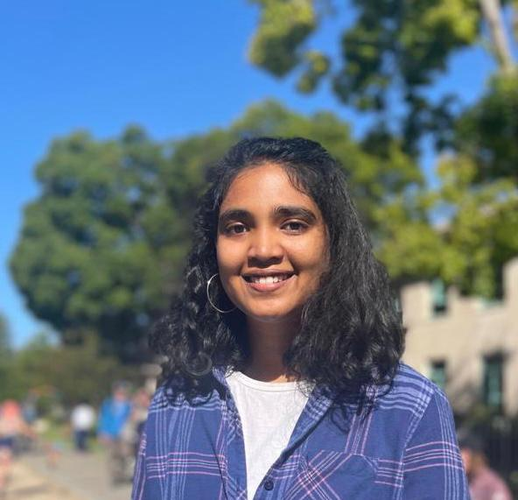
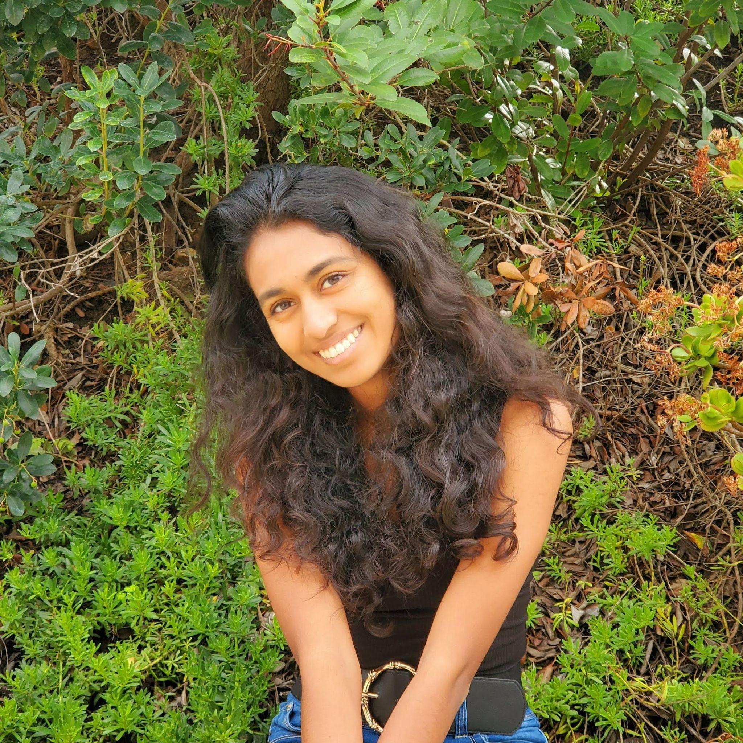

Our Team
Alyssa Chew
Varsha Senthil
Naya Menezes
Yuchen Song

Slide 3
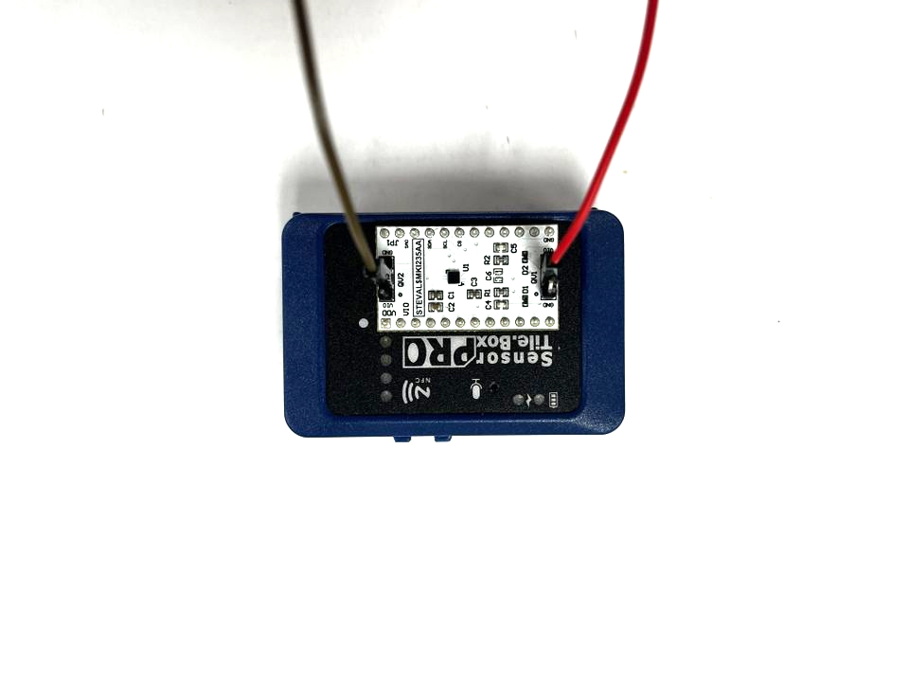
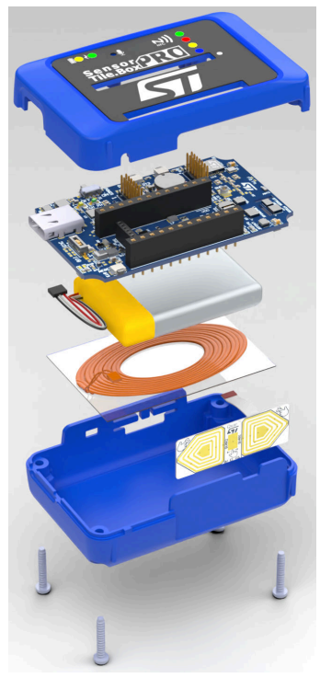
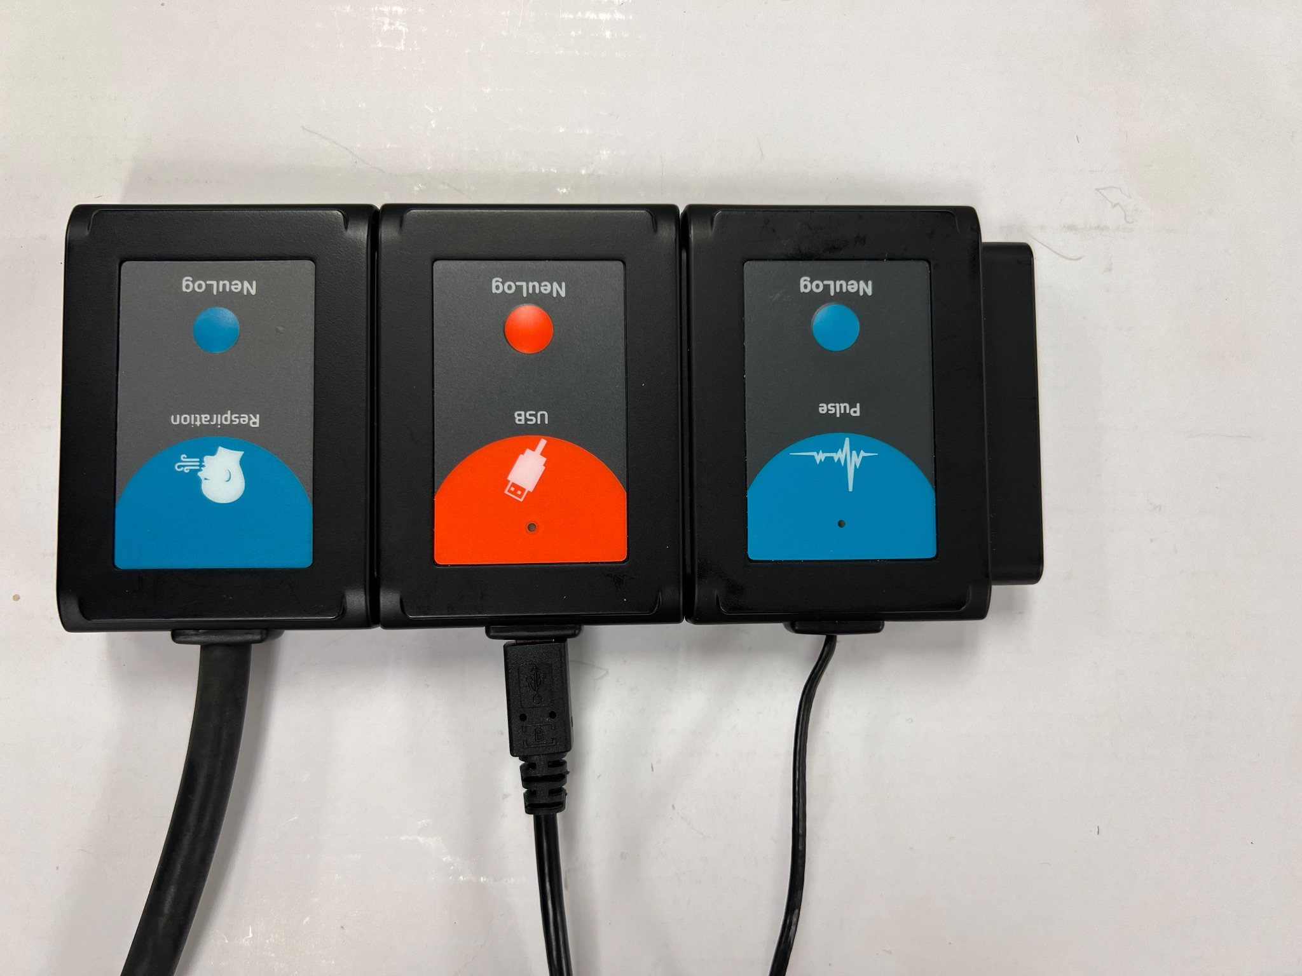
Problem Definition
Qvar for biosensing applications
Respiratory data collection + analysis
Qvar sensing options:
Radar
Electrodes
Placement
Number
Signal processing
Machine learning

Slide 4
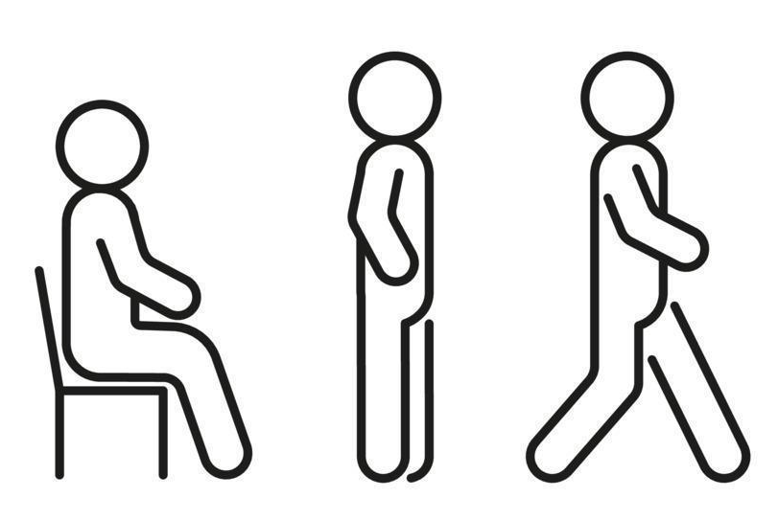
Methods
Simultaneous collection:
Qvar system
Ground Truth
15-20 samples / position / participant
3 positions (standing, sitting, walking)
4 participants (1 male, 3 female)
2 month experiment period

Slide 5
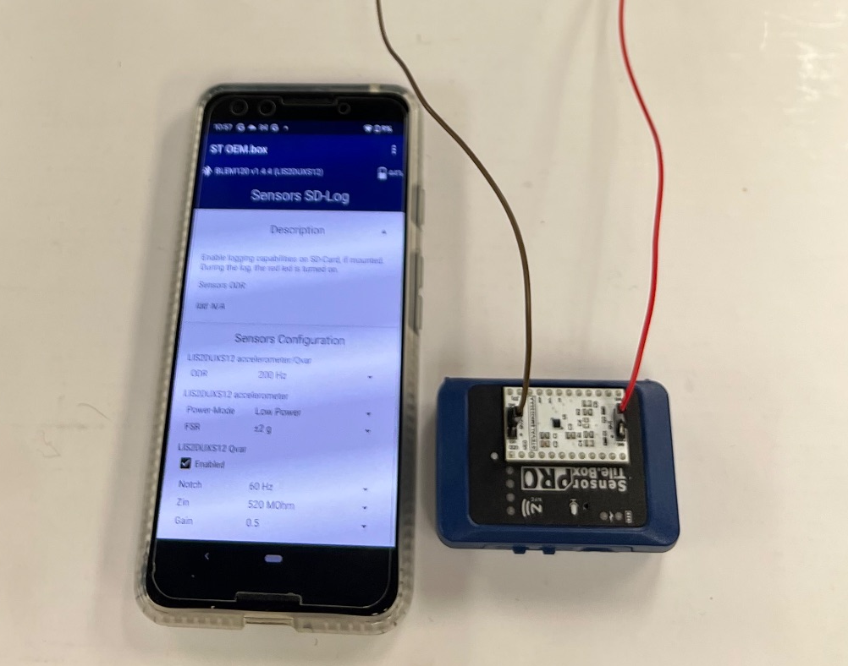
Setup
Sensors SD-Log on the ST OEM.box Application
Setting:
200Hz ODR
Enable Qvar
60Hz Notch
SensorTile.box PRO
Attach a Qvar sensor board
Connect cables on QVAR1 and QVAR2 pins

Slide 6
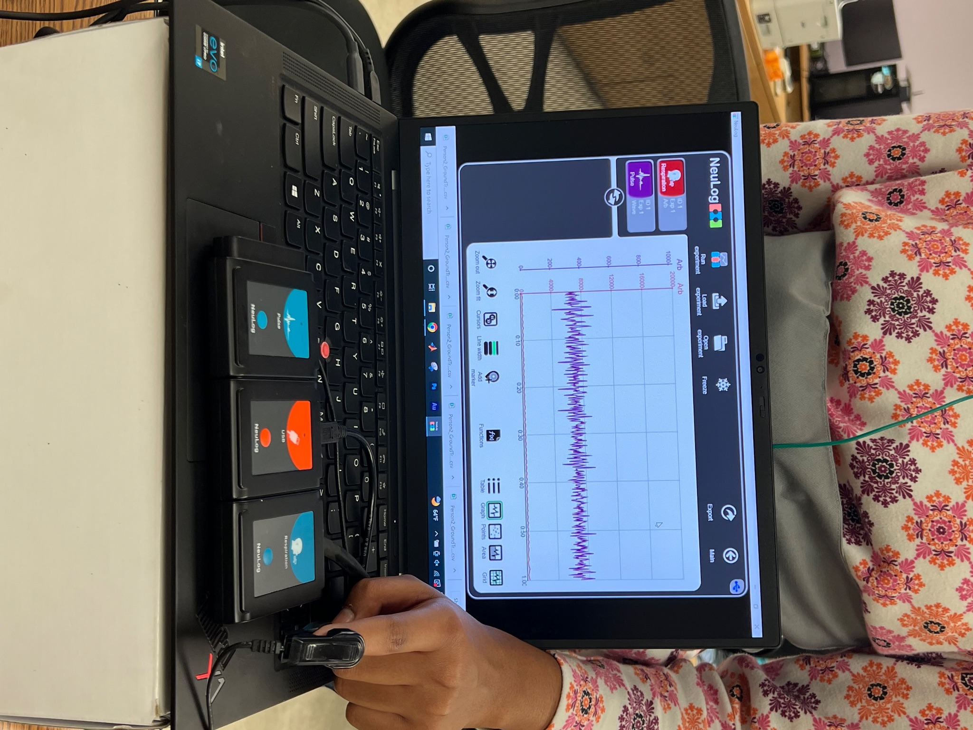
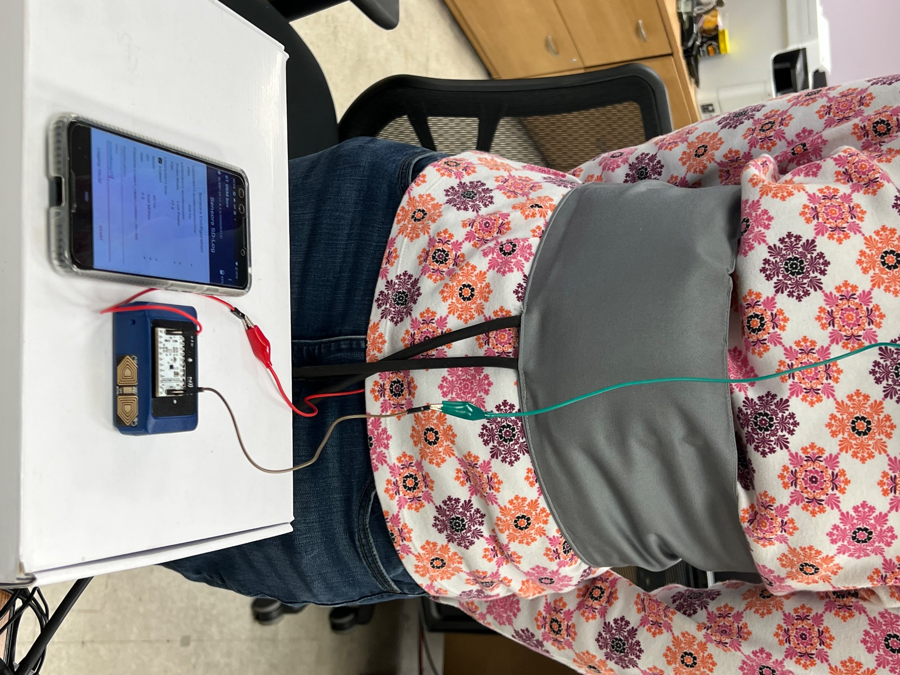
Setup (Ground Truth)
NeuLog Respiration Monitoring Belt Sensor
NeuLog Heart Rate and Pulse Sensor (NUL-236)
SensorTile.box PRO
NeuLog Respiration Monitoring Sensor (NUL-208)

Slide 7
Data Collection/Analyzing
Notes:
nathan

Slide 8
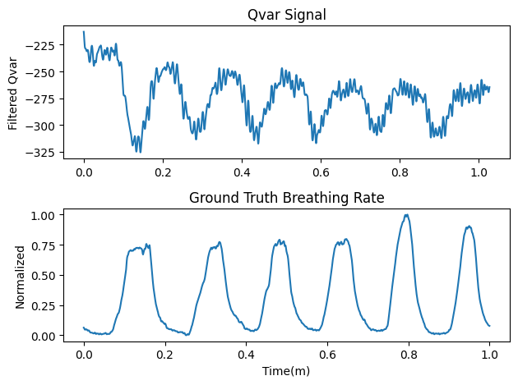
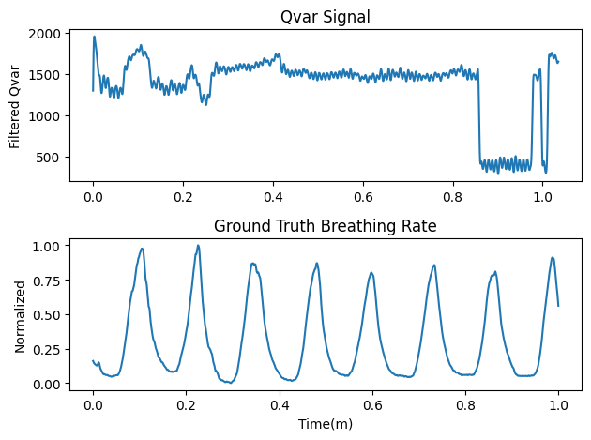
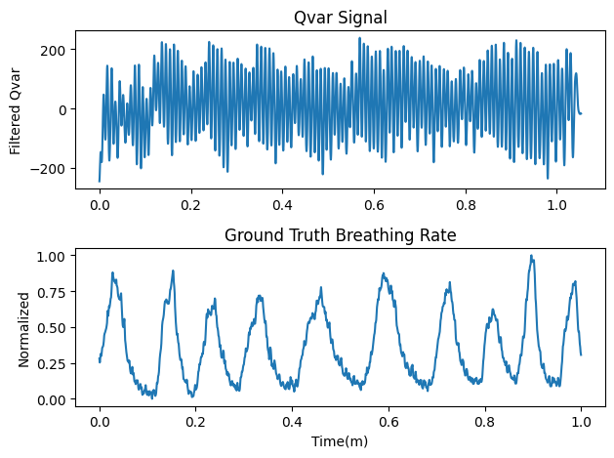
Qvar Respiration Data
Sitting, standing, and walking postures for each subject
1 minute per trial and 15-20 trials for each posture
Signal Processing
HeartPy - Python Heart Rate Analysis Toolkit
Person 3 Qvar and Ground Truth Sitting Sample
Person 3 Qvar and Ground Truth Standing Sample
Person 3 Qvar and Ground Truth Walking Sample

Slide 9
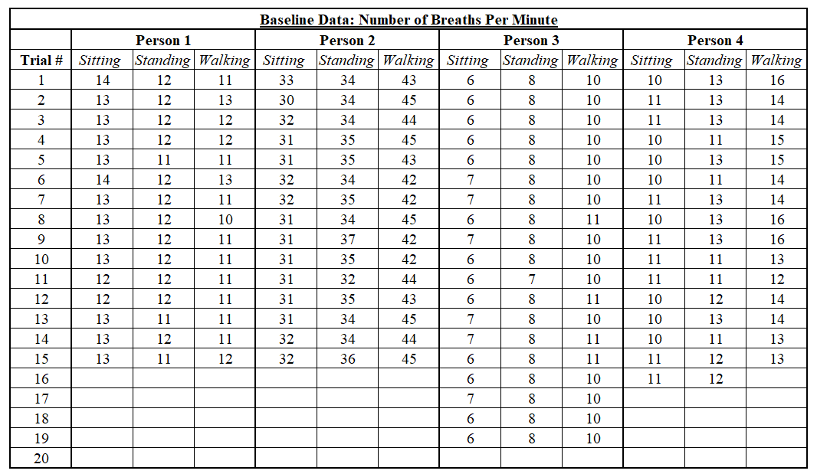
Ground Truth

Slide 10
Optimizing Parameters for Data Collection
Notes:
varsha

Slide 11
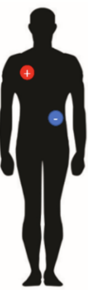
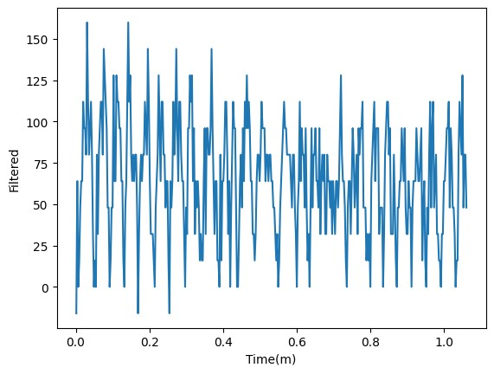
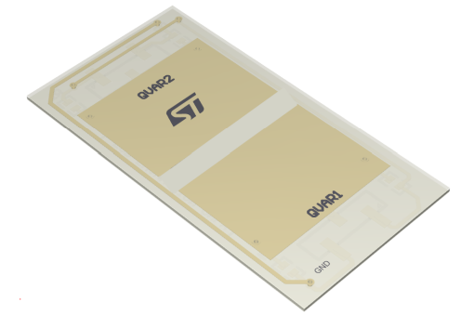
Testing Experimental Setups
Qvar Radar Sensor
Radar Attempt Filtered Data Sample
Electrode Placement Matching Research by Dheman et al.

Slide 12
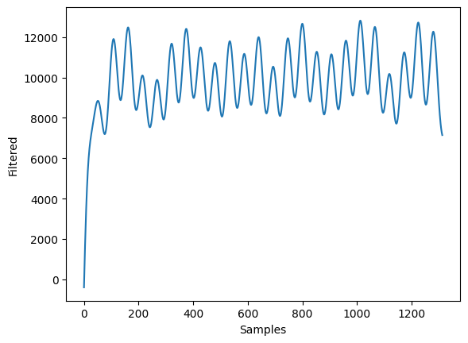
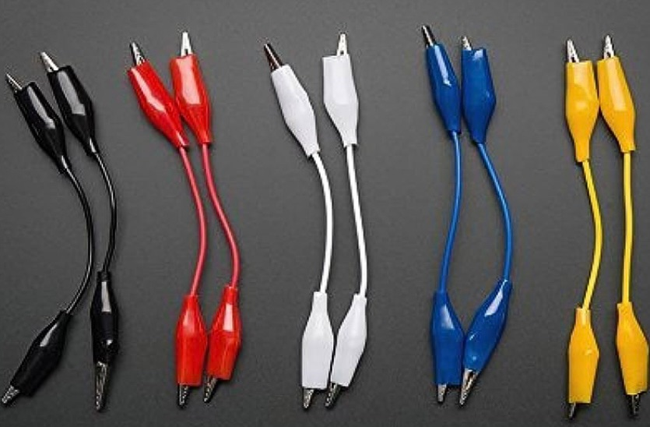
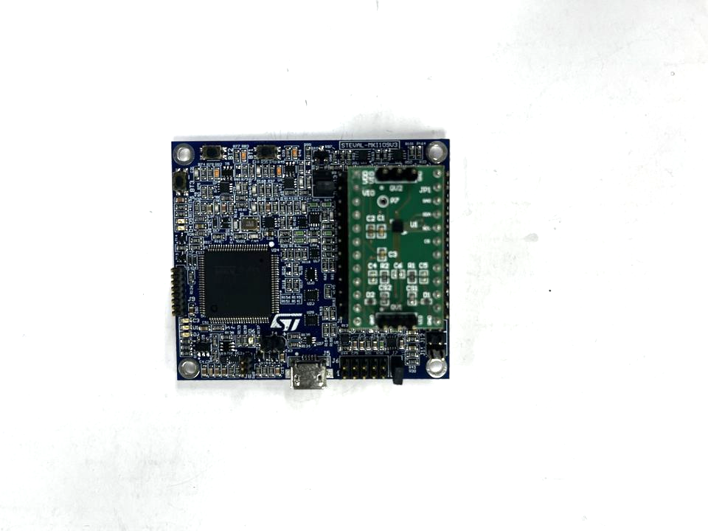
ProfiMEMS Sensor + Shielding Approaches
STENG1AX with the ProfiMEMS using Unico
Similar noise levels
Shorter wires
Aluminum foil
Electrical tape
ProfiMEMS Sensor Person 2 Filtered Data Sample: 0.18 Breathing Rate in HeartPy
Reducing Noise in Setup
ProfiMEMS Sensor

Slide 13
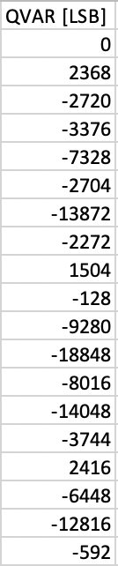
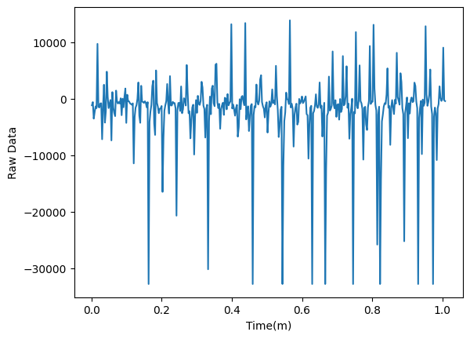
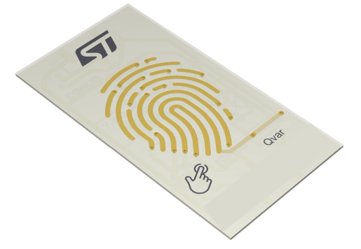
Noise Creation
Qvar touch sensor
Wires connected to QVAR1 & QVAR2
Noise patterns generated (taps on table)
Corresponding spikes
Noise Creation Raw Data
Qvar Touch Sensor
Noise Creation with Wires

Slide 14
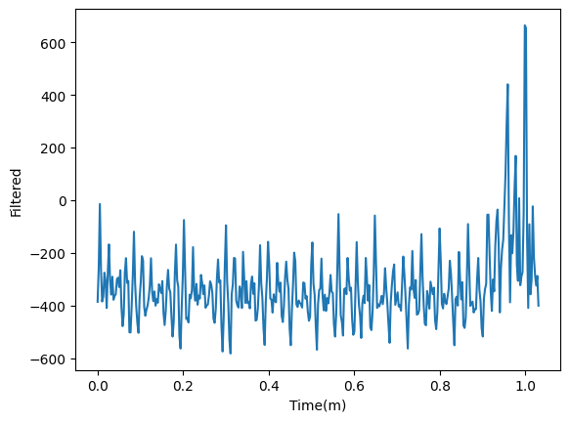
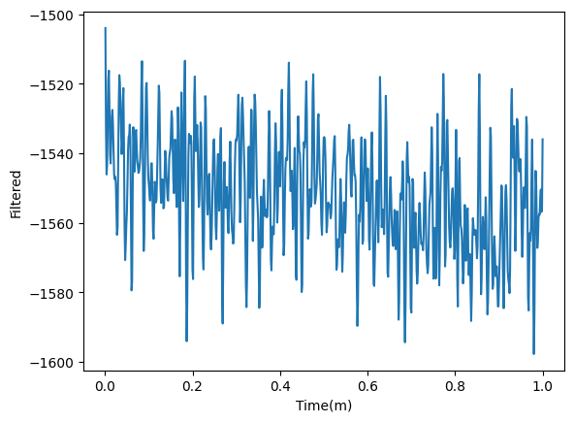
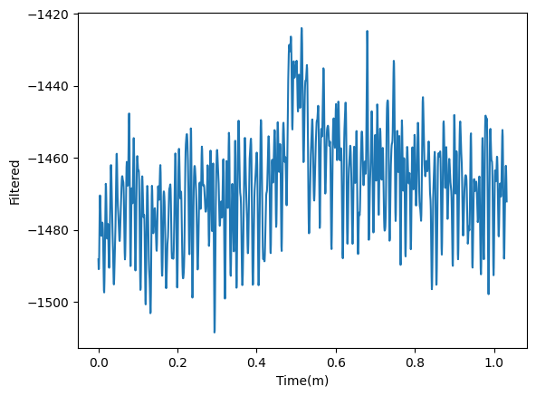
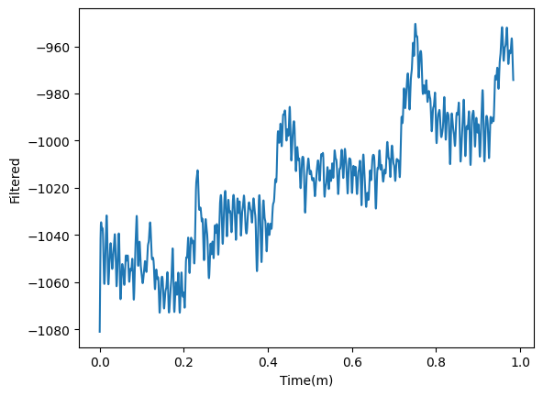
Output Data Rate (ODR)
Filtered 6 ODR Sitting Data Sample: 0.33 Breathing Rate in HeartPy
Filtered 25 ODR Sitting Data Sample: 0.14 Breathing Rate in HeartPy
Filtered 12.5 ODR Sitting Data Sample: 0.38 Breathing Rate in HeartPy
Filtered 200 ODR Sitting Data Sample: 0.20 Breathing Rate in HeartPy

Slide 15
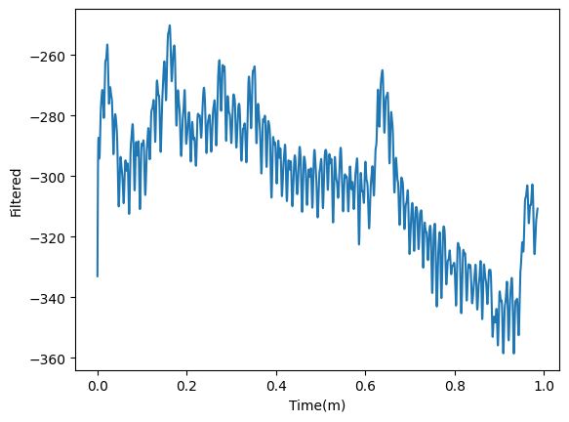
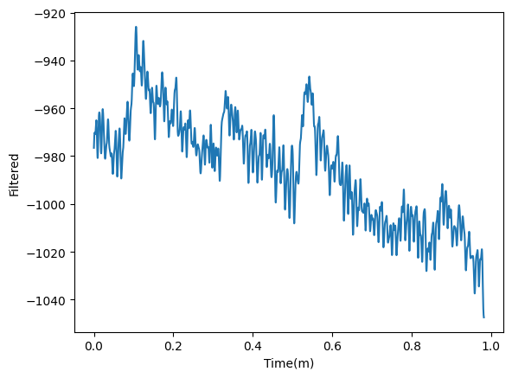
On Device Notch Filter
Filtered 50 Hz Notch Sitting Data Sample: 0.24 Breathing Rate in HeartPy
Filtered 60 Hz Notch Sitting Data Sample: 0.16 Breathing Rate in HeartPy

Slide 16
Machine Learning Approach
Notes:
naya

Slide 17
Preprocessing
Feed in Qvar as accelerometer data
Unico GUI
Built-in machine learning core
Produces a decision tree from the given data set along with decision tree statistics
Uses J48 tree training algorithm (implementation of the C4.5 algorithm (modification of the ID3 algorithm))
80%/20% training and validation data split
Classification only

Slide 18
Classification Labels
Breaths per minute:
6_to_10 11_to_15 16_to_20 21_to_25 26_to_30 31_to_35 36_to_40 41_to_45
Model Settings
Tested different window sizes: 52, 105, and 255
Tested no filter and with an HP ACC filter
Tested different number of nodes: 30, 50, and 80
Machine Learning Core ODR: 100 Hz
Accelerometer ODR: 200Hz
Confidence Factor: 0.9

Slide 19
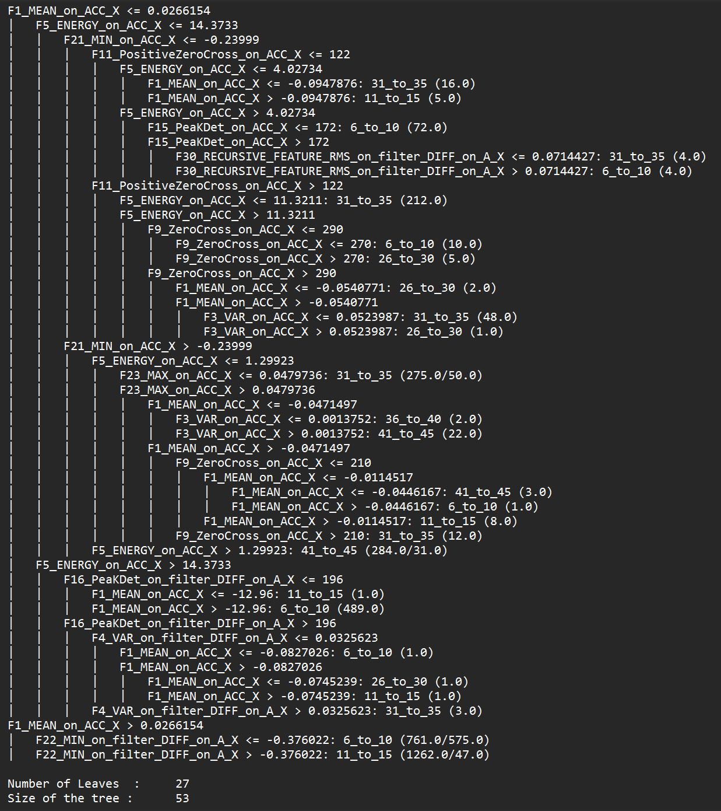
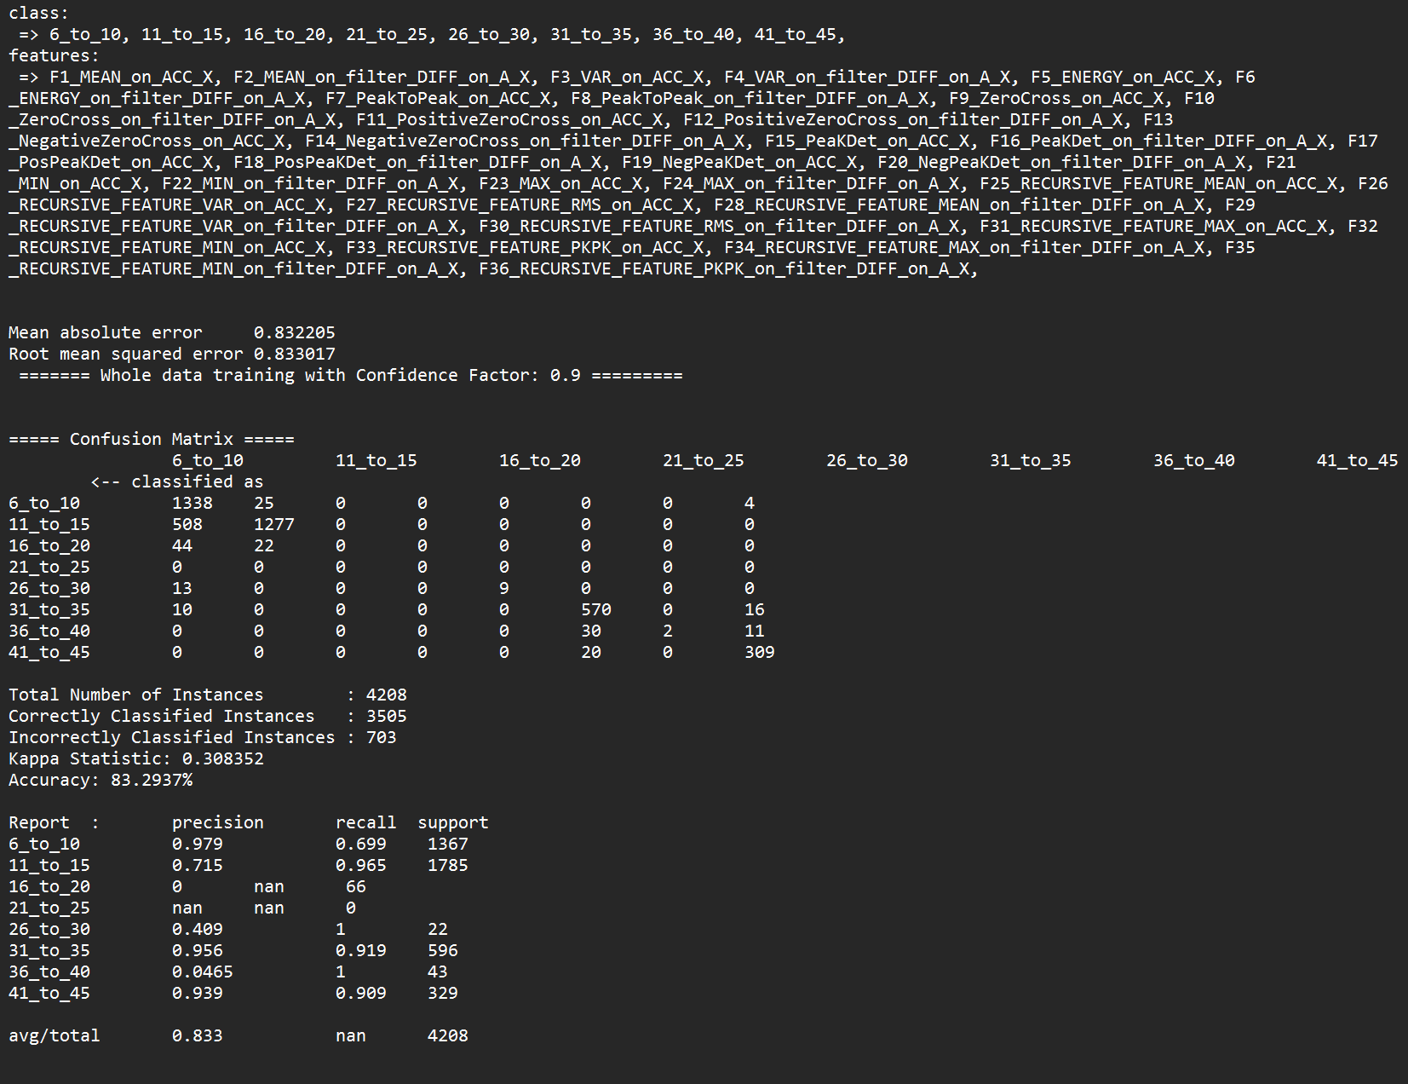
Model for All Data: 83.29%

Slide 20

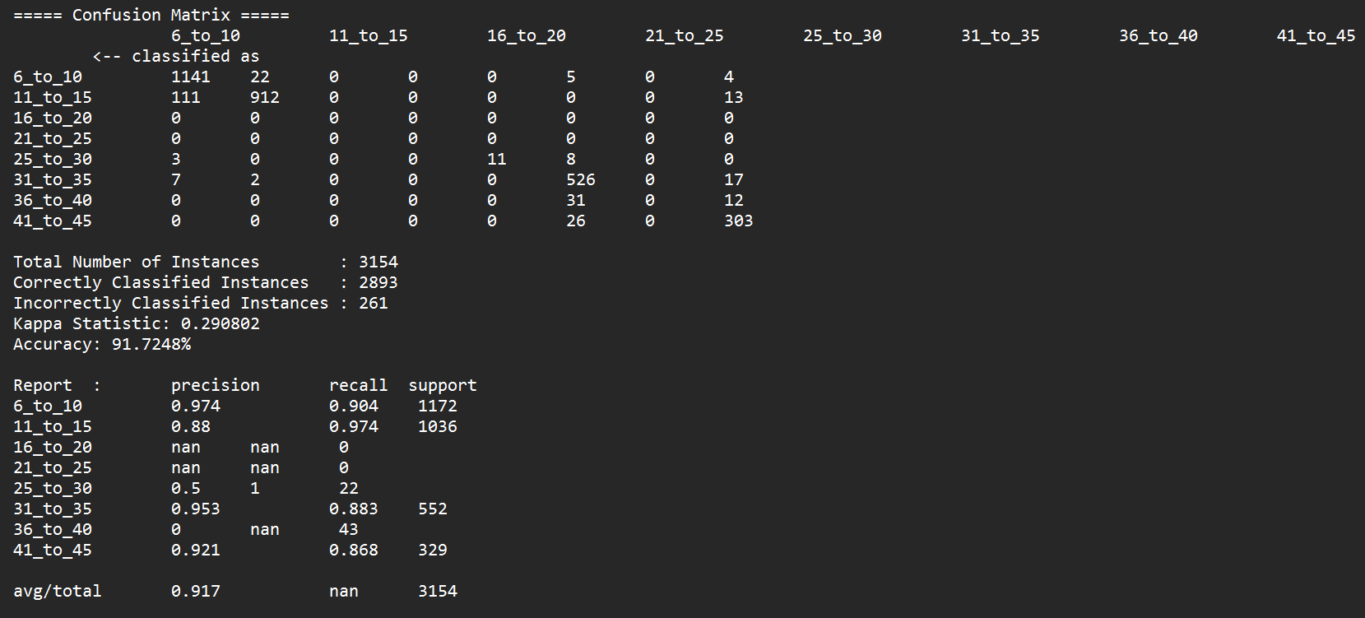
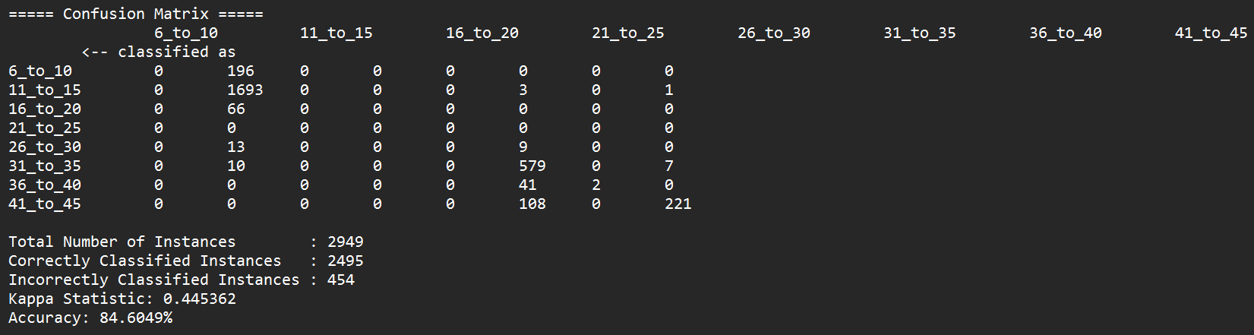
Confusion Matrices for Combinations of Three Participants
P1, P2, P3:
91.72%
P1, P2, P4:
84.60%

Slide 21
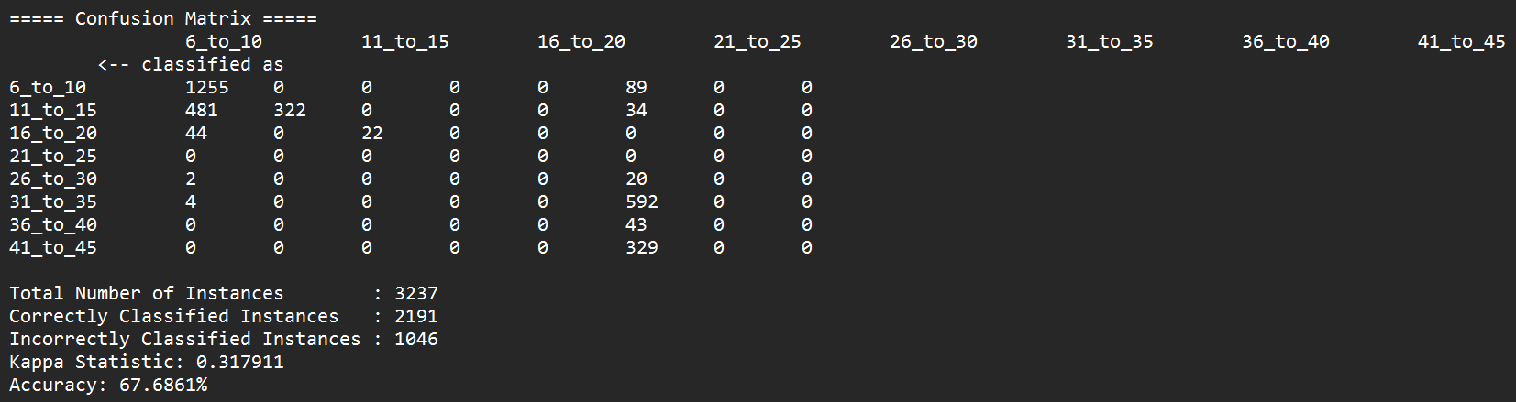
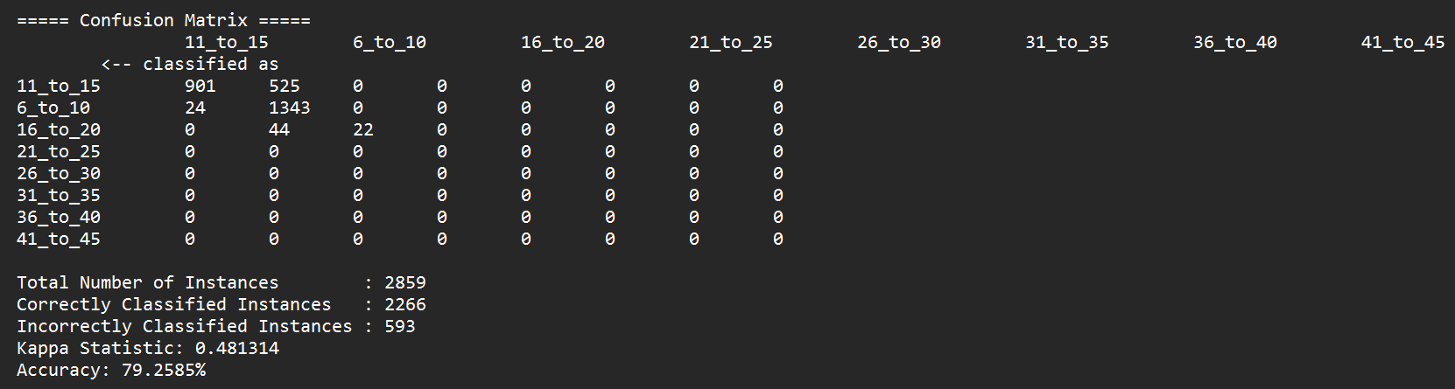
Confusion Matrices for Combinations of Three Participants
Cont.
P2, P3, P4:
67.69%
P1, P3, P4:
79.26%

Slide 22
Findings and Recommendations
Notes:
alyssa

Slide 23
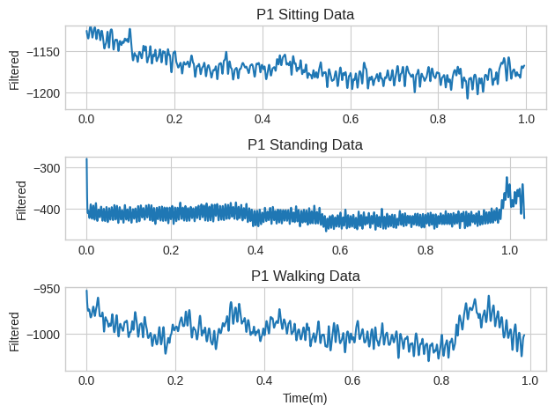
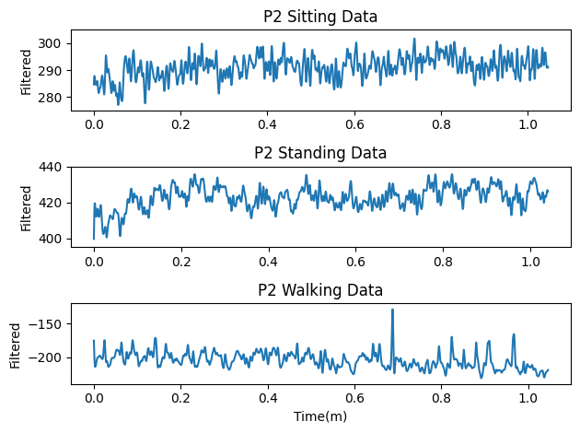
Impact of Posture, Activity and Physiology
Person 1 Sitting, Standing, and Walking Data Sample Comparison
Person 2 Sitting, Standing, and Walking Data Sample Comparison
Notes:
Small sample size
Participant 2
Data varies
Larger sample size required

Slide 24
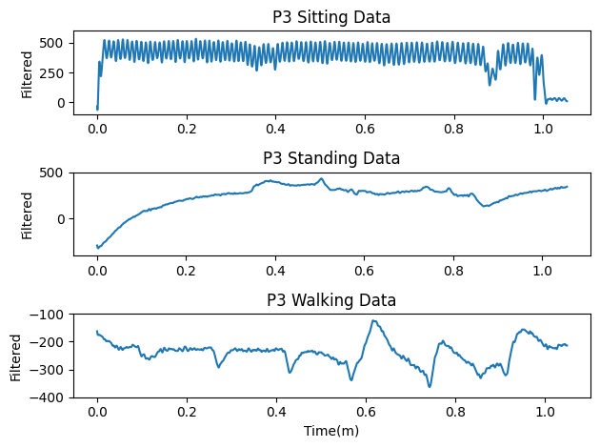
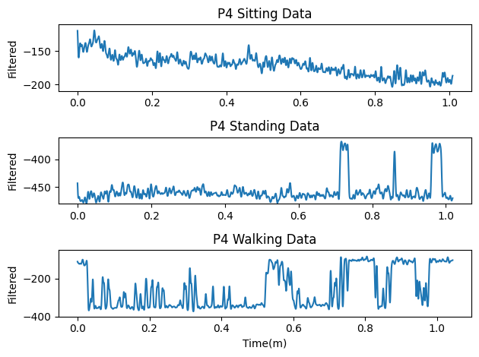
Impact of Posture, Activity and Physiology, Continued
Person 3 Sitting, Standing, and Walking Data Sample Comparison
Person 4 Sitting, Standing, and Walking Data Sample Comparison

Slide 25
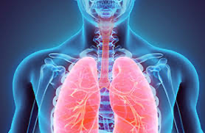
Impact of Gender
Controversial
Adult female lung volume 10-12% lower than adult male lung volume
No significant differences
Lung volume (credit: British Heart Foundation)

Slide 26
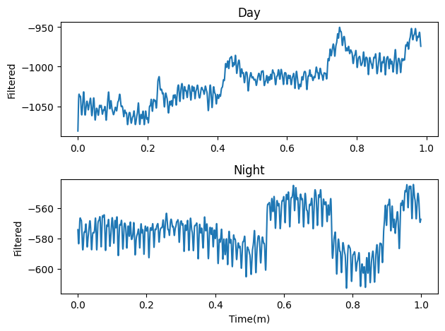
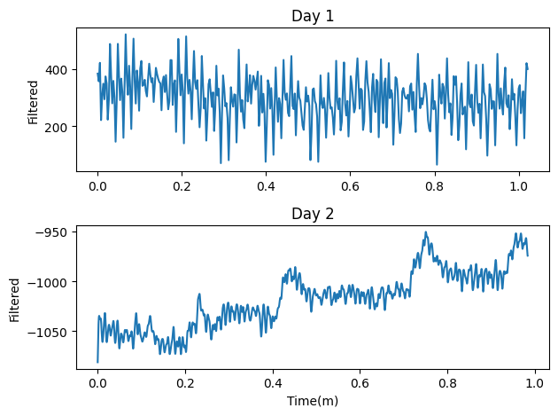
Impact of Time of Data Collection
Person 1 Sitting Samples at Two Different Times of Day
Person 1 Sitting Samples on Two Different Days

Slide 27
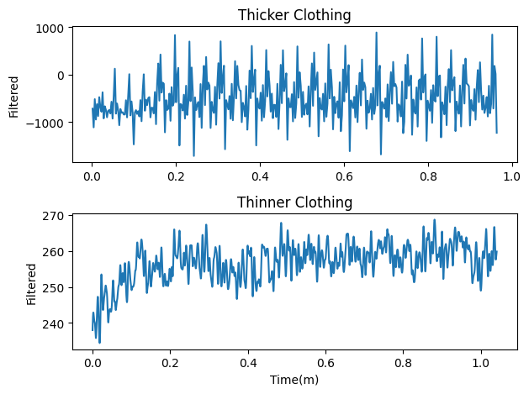
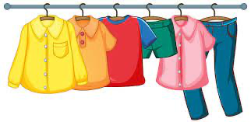
Impact of Clothing Worn During Data Collection
Thinner = conductive
Thicker = insulating
Looser = interference
Best: tighter, thicker
Person 2 sitting samples wearing different types of clothing

Slide 28

Overall Findings and Recommendations
Findings:
Qvar data is rather noisy
Unique breathing patterns
Hardware limitations
Recommendations:
Higher intensity activity
Larger sample size
Hardware with ECG capabilities
83.29% Overall Accuracy

Slide 29
Thank You!
Special thanks to Professor Mani Srivastava, Gaofeng Dong - UCLA ECE Department
Dr. Swapnil Sayan Saha & Dr. Mahesh Chowdhary - STMicroelectronics

